Slide 1
Methane Source Finder QC Portal Sketches
Rob Tapella
Nov 2020

Slide 2
Title

Slide 3
Full scenario
Joe Blah has some time to QC some scenes
He loads up the QC Portal which has all the internal data and which can view and approve new plumes
JB goes to the QC tab on the left to see which flight lines are available for QC
JB see that there are 24 flight lines to QC and chooses the earliest to get started
The UI loads up the list of plume detections in a list plus a visualization of the plumes on the map
Also loaded are associated processing/QC layers, wind data, the greyscale map, flares, and the AVIRIS RGB layer
Each of the dot colors (and/or shapes) indicates if it has been QC’d
JB goes through each dot he sees on the map; first zooming in on the dot, deciding if it’s real or not, then setting an appropriate disposition
Once all the plumes are set as “good” or “bad”, he goes back over the flight line to see if there are missing plumes
He notices a few plumes that are missing. He “adds” a plume each time and sets the location, then adds some basic metadata
He notices one plume that he had marked as TP looks a bit off from where it shows up in the greyscale/IR layer. He goes into the details of that plume and “re-sets” the location
He scans through the list view to quickly make sure that he got to all the plumes that were detected by the CNN
It looks good; he indicates that this flight line has been QC’d, and it is removed from the “to be QC’d” flight line list; the system does whatever post-processing is needed to save the approved plumes to the public data set

Slide 4
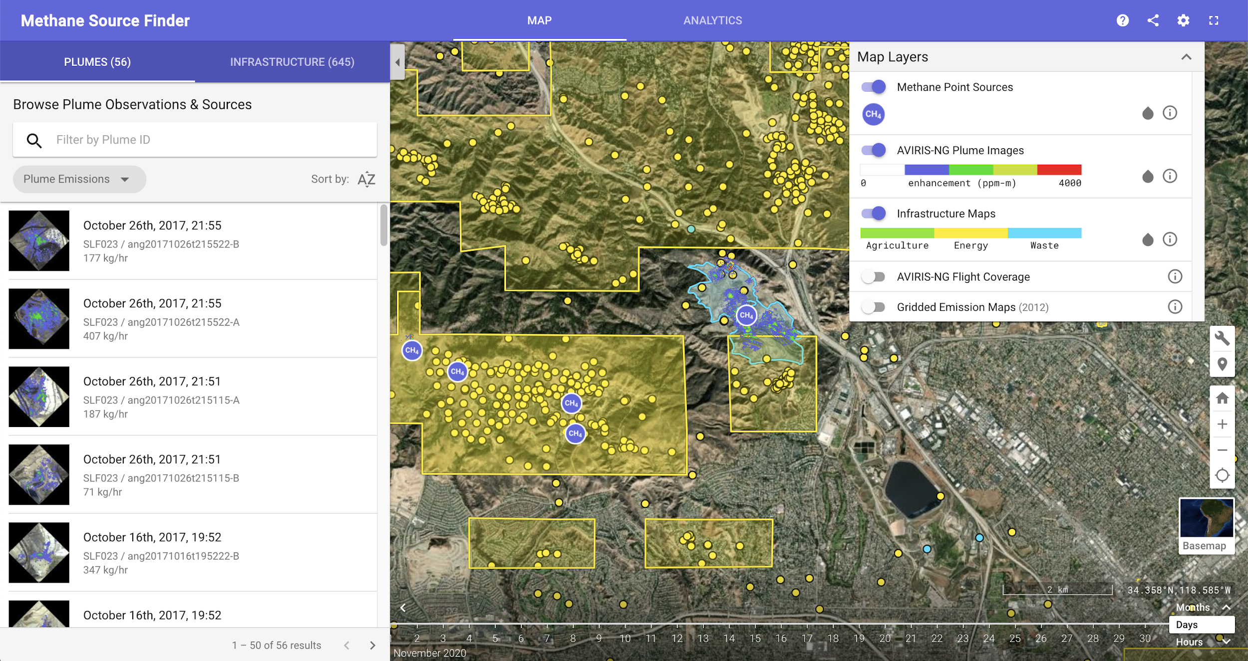

Slide 5
The scenario begins...
Joe Blah has time to QC some scenes
He loads up the QC Portal which has all the internal data and which can view and approve new plumes

Slide 6
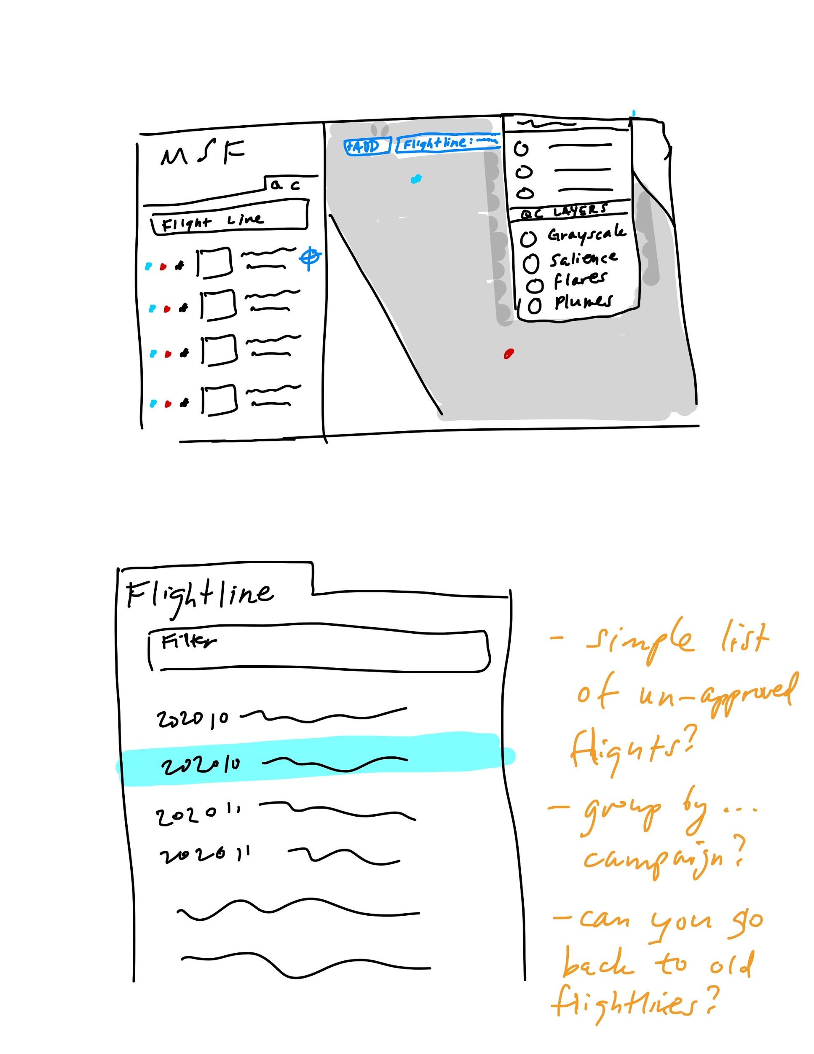
Choose a flight line to QC
JB goes to the QC tab on the left to see which flight lines are available for QC
JB sees that there are 24 flight lines to QC and chooses the second one to get started

Slide 7
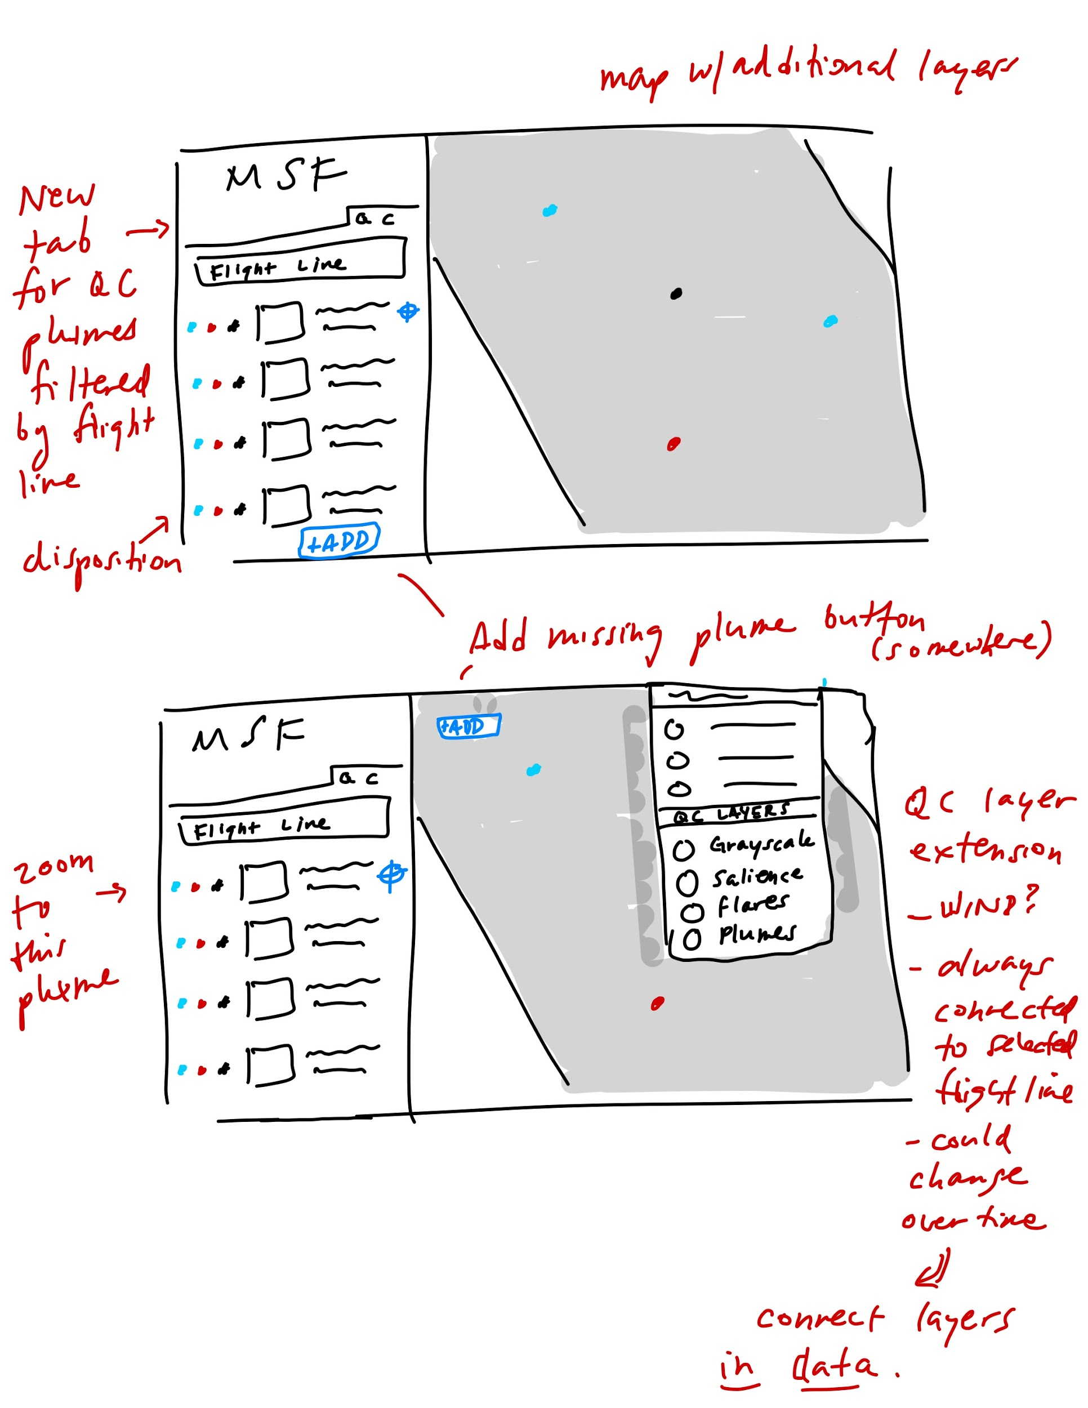
Mark each plume TP/FP/etc.
The UI loads up the list of plume detections in a list plus a visualization of the plumes on the map
Also loaded are associated processing/QC layers, wind data, the greyscale map, flares, and the AVIRIS RGB layer
Each of the dot colors (and/or shapes) indicates if it has been QC’d
JB goes through each dot he sees on the map; first zooming in on the dot, deciding if it’s real or not, then setting an appropriate disposition
Each dot (and list-item on the left) has some metadata associated with it like the flux
Notes:
Whiteboard notes from Charting Users & Use Cases

Slide 8
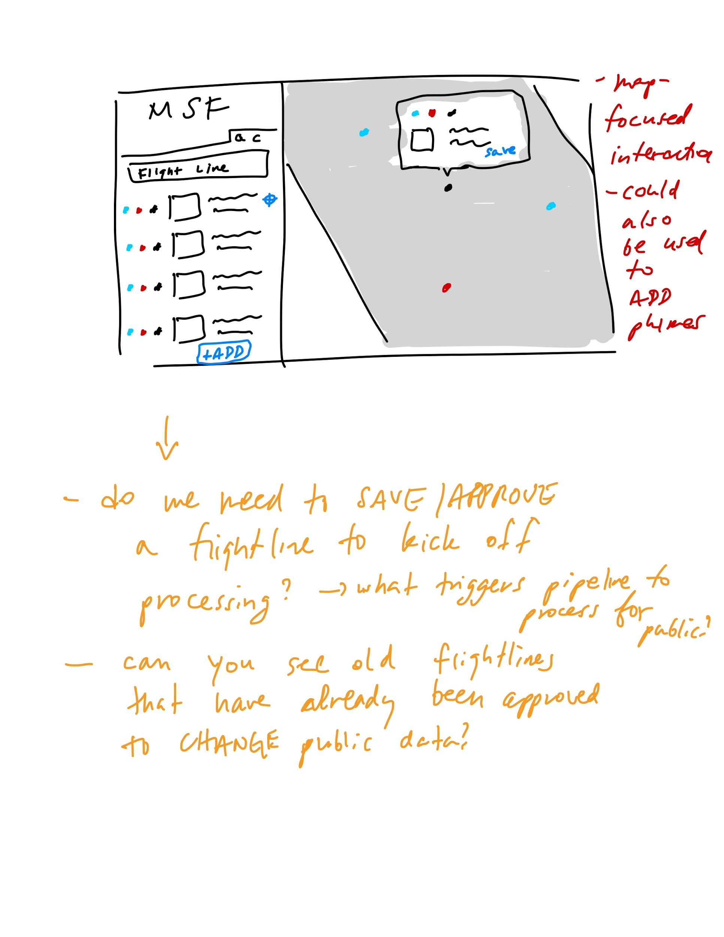
Add missing plumes (FNs)
Once all the plumes are set as “good” or “bad”, he goes back over the flight line to see if there are missing plumes
He notices a few plumes that are missing. He “adds” a plume each time and sets the location, then adds some basic metadata
He notices one plume that he had marked as TP looks a bit off from where it shows up in the greyscale/IR layer. He goes into the details of that plume and “re-sets” the location

Slide 9
Check for completeness and “check off” flight line
He scans through the list view to quickly make sure that he got to all the plumes that were detected by the CNN
It looks good; he indicates that this flight line has been QC’d, and it is removed from the “to be QC’d” flight line list; the system does whatever post-processing is needed to save the approved plumes to the public data set
Notes:
Whiteboard notes from Charting Users & Use Cases

Slide 10
Choose a flight line to QC
JB goes to the QC tab on the left to see which flight lines are available for QC
JB sees that there are 24 flight lines to QC and chooses the second one to get started

